Slide 1

Falmouth Soccer Club
Curriculum and Development Model

Slide 2
OUR VISION
To be the premier destination for competitive soccer in Falmouth, nurturing a culture of excellence, growth, and character building while ensuring every player finds their place at the right level of soccer for their abilities.

Slide 3
GUIDING PRINCIPLES
Central to our ethos is the core values of:
1. Selflessness: Exemplified through acts of teamwork and sacrifice that elevate the collective above the individual.
2. Positive attitude: A beacon of optimism guiding players through setbacks and victories alike.
3. Preparation for life: Equipping each athlete with the resilience and adaptability to navigate the complexities of the world.
4. Unwavering effort: The bedrock of success, inspires players to push beyond their limits with each training session and match.
5. Commitment: Coaches are deeply committed to nurturing players’ on-field development, preparing them for the challenges of the next level of soccer with tailored training and guidance, and ensuring they emerge as skilled and confident athletes.
In this spirit, we endeavor to create an inclusive and supportive community, where every player is valued not just for their skill on the ball, but for the content of their character. Our vision extends beyond the boundaries of our fields, aspiring to cultivate not just skilled athletes, but compassionate leaders, ready to make their mark on the world."

Slide 4
PLAYING
Our club is committed to playing aggressive, smart, and dynamic soccer.
Aggressive means we press with intensity, challenge every ball, and compete with relentless energy. We want opponents to feel constant pressure—whether we’re attacking or defending—through physical commitment, quick reactions, and a winning mentality.
Smart means we play with purpose. Every movement, pass, and decision is intentional. We focus on reading the game, exploiting space, and adapting quickly to different situations. Intelligence in positioning, ball circulation, and tactical awareness allows us to outthink our opponents, not just outwork them.
Dynamic means our play is fluid, creative, and unpredictable. We move as a unit, switch roles seamlessly, and keep the tempo high. Our players are encouraged to express themselves, combine quickly, and attack with speed and variety. Defensively, we transition rapidly to regain control and dictate the rhythm of the match.
This style represents the identity of our club: fearless, thoughtful, and constantly evolving. It’s not just about winning games—it’s about building a culture of intensity, intelligence, and creativity that excites our players, challenges our opponents, and inspires our supporters.

Slide 5
ATTACKING STYLE
Our attacking philosophy is built on possession with purpose, constant movement, and decisive penetration. Regardless of formation, we aim to:
Build with control – Play out with composure, using quick, simple passes to progress the ball through the thirds while maintaining patience and balance.
Create space through movement – Players rotate, check in, and stretch the field both vertically and horizontally to disrupt defensive lines.
Attack with numbers – Once space is created, we commit runners from midfield and wide areas to support the attack, ensuring multiple options in and around the box.
Play forward decisively – Prioritize vertical passes and combinations that break lines, while encouraging creativity in the final third.
Transition quickly – On turnovers, immediately look to exploit the opponent before they are organized, using speed and direct play.
This plan allows us to stay proactive, adaptable, and dangerous no matter the system we line up in. The goal is always to control the tempo, create high-quality chances, and finish attacks with conviction.

Slide 6
DEFENDING STYLE
Our defensive philosophy is built on organization, pressure, and rapid transitions. Regardless of formation, we aim to:
Defend as a unit – Stay compact between lines, shift together, and maintain balance to deny space in central areas.
Apply intelligent pressure – Press the ball aggressively but with purpose, forcing play into predictable areas where we can regain possession.
Win the transition – The moment we lose the ball, react immediately with counter-pressure to disrupt the opponent before they can build.
Protect dangerous spaces – Prioritize covering the box, wide channels, and passing lanes into goal-scoring areas.
Turn defense into attack – Once possession is regained, transition quickly to exploit the opponent’s disorganization and launch our attacking plan.
This approach keeps us disciplined, relentless, and adaptable, ensuring that our defense is not just about preventing goals, but also about creating the foundation for our attack.

Slide 7
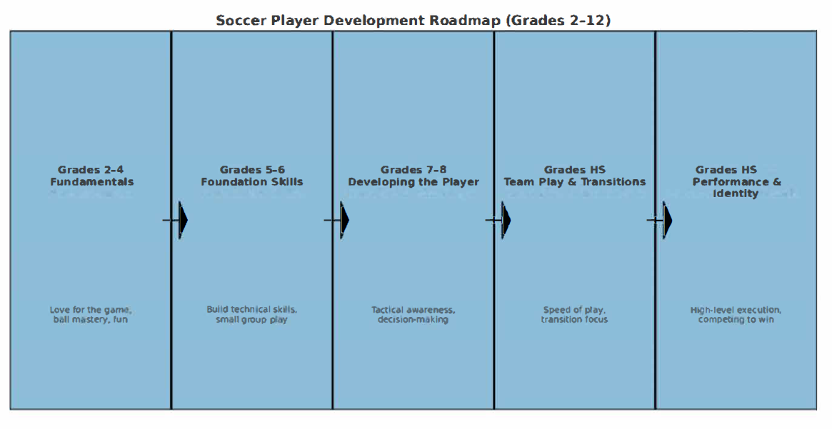
PHASES OF PLAY

Slide 8
Overall Philosophy
Development is progressive and age-appropriate—building from joy and fundamentals in the early years, to tactical awareness and team identity in later years. Winning matters less than growth at younger ages, but by high school, players should be competing with intensity, intelligence, and creativity.

Slide 9
Grades 2-4
Fundamentals
Focus: Love for the game, ball mastery, and enjoyment.
Key Development Goals:
  Dribbling with all parts of the foot
  Simple 1v1 attacking and defending
  Basic passing and receiving
  Introduction to spacing (don’t all chase the ball)
  Sportsmanship, teamwork, and having fun

Slide 10
Grades 5-6
Foundation Skills
Focus: Building technical ability and game understanding.
Key Development Goals:
  Improving first touch and control under pressure
  Short passing/receiving in different directions
  Basic combination play (give-and-go, overlaps)
  Introduction to small-group defending (2v2, 3v3)
  Learning positions and roles on the field

Slide 11
Grades 7-8
Developing the Player
Focus: Expanding tactical awareness and decision-making.
Key Development Goals:
  Playing with head up, scanning before receiving
  Switching play and using width
  Basic pressing and covering in defense
  Movement off the ball (checking in/out, making runs)
  Introduction to strength, agility, and coordination training
  Nurturing resilience and confidence

Slide 12
Grades HS
Team Play & Transitions
Focus: Speed of play, tactical flexibility, and transitions.
Key Development Goals:
  Quick decision-making under pressure
  Playing out of the back and organized buildup
  Compact defending and counter-pressing
  Structured attacking patterns (overlaps, third-man runs, through balls)
  Physical development (endurance, speed, injury prevention)
  Building leadership and communication on the field

Slide 13
Grades HS
Performance & Identity
Focus: High-level execution, adaptability, and competing to win.
Key Development Goals:
  Mastery of technical skills under game intensity
  Understanding and executing multiple formations/systems
  Advanced pressing, counter-pressing, and defensive organization
  Creating and finishing scoring chances in varied ways
  Position-specific roles and specialization
  Mental toughness, preparation, and consistency
  Preparing for post-high school play (college, club, or lifelong soccer)

Slide 14
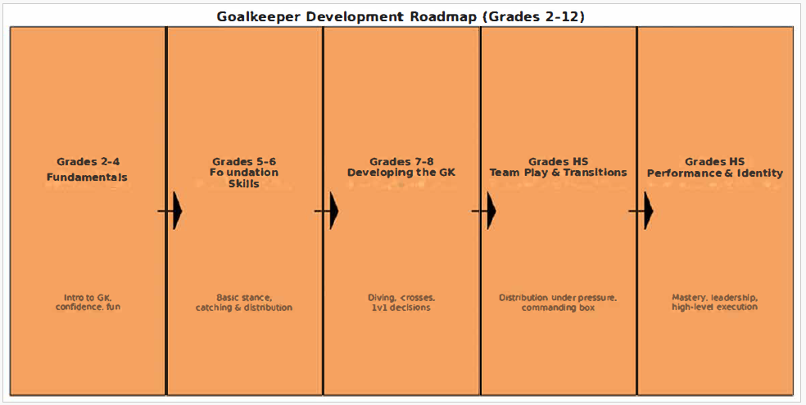
GOALKEEPING

Slide 15
Overall Philosophy
Goalkeeper development should move from basic handling and confidence in the early years, toward commanding presence, leadership, and tactical execution in the later years. Every phase reinforces the keeper’s dual role as both a shot-stopper and first attacker.

Slide 16
Grades 2–4
Fundamentals of Goalkeeping
Focus: Introduce the position in a fun, safe way.
Key Goals:
  Basic catching and rolling techniques
  Understanding when to use hands vs. feet
  Getting comfortable diving on soft surfaces
  Simple positioning in front of goal
  Confidence, bravery, and enjoyment

Slide 17
Grades 5-6
Foundation Skills
Focus: Establish technical building blocks.
Key Goals:
  Proper stance and footwork
  Handling low, mid, and high balls consistently
  Introduction to distribution (throws, punts, short passes)
  Understanding angles and positioning in goal
  Communication with defenders (“man on,” “keeper’s ball”)

Slide 18
Grades 7-8
Developing the Goalkeeper
Focus: Expanding technique and game awareness.
Key Goals:
  Diving to both sides with proper technique
  Starting command of the penalty area (claiming crosses)
  Playing with feet: short passing, simple long balls
  1v1 decision-making (close down vs. hold position)
  Beginning to organize defenders on set pieces
  Building confidence, resilience, and quick recovery after mistakes

Slide 19
Grades HS
Team Play & Transitions
Focus: Becoming an integral part of the team’s system.
Key Goals:
  Advanced distribution: building out of the back under pressure
  Timing and bravery in aerial duels/crosses
  Anticipation and reading the game (sweeper-keeper skills)
  Consistent shot-stopping under pressure
  Leadership in defensive organization and communication
  Strength, agility, and explosiveness training

Slide 20
Grades HS
Performance & Identity
Focus: High-performance execution, leadership, and preparation for higher levels.
Key Goals:
  Mastery of all handling, diving, and distribution techniques
  Commanding the box with presence and communication
  Understanding and executing tactical systems from the back
  Mental strength: focus, resilience, and leadership under pressure
  Preparing for advanced competition (college showcase, club level, or beyond)
  Developing personal style/identity as a goalkeeper

Slide 21
Training Model
Ties everything together:
Field Player Roadmap (2–12)
Goalkeeper Roadmap (2–12)
Attacking/Defensive Plans & Club Philosophy
This model ensures your club has one unified development pathway with clear priorities at each stage.

Slide 22
Soccer Club Training Model (Grades 2–12)
1. Core Philosophy
Style of Play: Aggressive, smart, and dynamic.
Identity: Press with intensity, play with intelligence, attack with creativity.
Team Principles:
  Attacking → Possession with purpose, space creation, decisive penetration.
  Defending → Compact organization, purposeful pressure, quick transition to attack.
Keeper Role: First defender, first attacker. Command the box, distribute smartly, lead with communication.

Slide 23
Training Model
2. Development Stages (Players & Goalkeepers)
Grades 2–4 (Fundamentals)
Players: Dribbling, 1v1s, spacing, teamwork.
Goalkeepers: Intro to catching, stance, bravery, fun in goal.
Training Balance: 80% fun/skills, 20% team shape.
Grades 5-6 (Foundation Skills)
Players: Passing/receiving, small group play, basic positions.
Goalkeepers: Handling, simple distribution, angles.
Training Balance: 70% technical, 30% team play.
Grades 7-8 (Developing the Player / GK)
Players: Tactical awareness, movement off the ball, small group defending.
Goalkeepers: Diving, crosses, 1v1s, organizing defenders.
Training Balance: 60% technical/tactical, 40% team play & decision-making.

Slide 24
Training Model
Grades HS (Team Play & Transitions)
Players: Speed of play, transitions, pressing, buildup patterns.
Goalkeepers: Distribution under pressure, aerial command, sweeper-keeper play.
Training Balance: 50% tactical, 30% technical, 20% physical/mental.
Grades HS (Performance & Identity)
Players: High-level execution, multiple systems, position-specific mastery.
Goalkeepers: Leadership, tactical execution, elite shot-stopping & distribution.
Training Balance: 40% tactical, 30% technical, 20% physical, 10% mental/leadership.

Slide 25
Training Model
3. Session Structure (Universal Model)
Every training session should contain these elements, weighted by age group:
Warm-Up & Ball Mastery (10–15 min) – Technical touches, agility, coordination.
Technical/Tactical Theme (25–30 min) – Passing patterns, pressing drills, finishing, GK handling.
Small-Sided Games (20–25 min) – Age-appropriate numbers (3v3 → 5v5 → 7v7 → 11v11).
Conditioned Game / Phase Play (20 min) – Apply attacking/defensive principles in realistic settings.
Cool Down & Reflection (5–10 min) – Mental recovery, feedback, team culture.

Slide 26
Training Model
4. Development Pillars
Technical: Mastery of ball (all ages).
Tactical: Increasing complexity by stage.
Physical: Agility, strength, endurance.
Psychological: Confidence, resilience, leadership.
Social: Teamwork, communication, enjoyment.

Slide 27
Training Model
This model ensures:
Younger players → Focus on love of the game + ball skills.
Middle years → Grow tactical understanding + teamwork.
High school years → Refine performance + leadership.

Slide 28
TECHNICAL
Technical Training Pillars (All Ages)
Ball Mastery → Foundation for all skills.
Passing & Receiving → Accuracy, control, and vision.
Finishing → Repetition of shooting in realistic settings.
1v1s → Attacking creativity & defensive discipline.
Aerial Play → Heading for players, handling for keepers.
Distribution (GK + Players) → Both feet, short and long.

Slide 29
TECHNICAL
Grades 2–4 (Fundamentals)
Ball Mastery: Dribbling with all surfaces, simple turns (inside/outside cuts), toe touches.
Passing/Receiving: Basic inside-foot passes, stopping the ball, trapping with sole.
Shooting: Kicking with laces, striking a stationary ball, fun finishing games.
1v1s: Simple attacking moves, shielding ball.
Goalkeepers: Catching rolling balls, simple throws, learning stance.
Grades 5-6 (Foundation Skills)
Ball Mastery: More advanced turns (Cruyff, drag-back, step-overs).
Passing/Receiving: Passing with both feet, first-touch control, receiving on the move.
Shooting: Striking moving balls, volleys, accuracy over power.
1v1s/Defending: Tackling technique, body position.
Goalkeepers: Handling low/mid/high balls, basic footwork, short distribution.

Slide 30
TECHNICAL
Grades 7-8 (Developing the Player/GK)
Ball Mastery: Fakes/feints, shielding under pressure.
Passing/Receiving: One-touch passing, playing in different directions.
Shooting: Finishing off the dribble, headers, weak-foot development.
Defending: 1v1 defending, jockeying, small group defending (2v2).
Goalkeepers: Diving techniques, 1v1 saves, distribution with hands/feet, positioning.
Grades HS
(Team Play & Transitions)
Ball Mastery: Speed dribbling into space, advanced combination moves.
Passing/Receiving: Long passing, driven passes, switching play.
Shooting: First-time finishing, finishing under pressure, volleys & crosses.
Defending: Pressing angles, defending as a unit.
Goalkeepers: Handling under pressure, crosses, long distribution, sweeper-keeper play.
(Performance & Identity)
Ball Mastery: Applying moves at game speed against real pressure.
Passing/Receiving: Precision passing at high tempo, disguised passes.
Shooting: Clinical finishing, volleys, finishing in tight spaces, set-piece delivery.
Defending: Mastery of 1v1, pressing systems, aerial duels.
Goalkeepers: Elite shot-stopping, commanding box, tactical distribution, leadership with ball.

Slide 31
TECHNICAL
This model makes sure each grade level has clear technical priorities, building from basic ball familiarity to high-performance mastery by graduation.

Slide 32
CONCLUSION
Building the Complete Player
Our training model provides a clear and progressive pathway from Grades 2–12, ensuring every player — field player or goalkeeper — develops in a way that is age-appropriate, challenging, and inspiring.
In the early years, the focus is on joy, confidence, and technical foundations.
In the middle years, we emphasize tactical awareness, teamwork, and decision-making.
In the later years, we refine performance, leadership, and identity, preparing players to succeed at the highest level they aspire to.
This pathway aligns with our club philosophy of playing aggressive, smart, and dynamic soccer:
Aggressive in our pressing and competitiveness,
Smart in our decision-making and tactical awareness,
Dynamic in our creativity, movement, and ability to adapt.
Our field player roadmap, goalkeeper pathway, and technical skills model all work together to ensure that every athlete grows not only in skill, but also in confidence, resilience, and love for the game.
Ultimately, our goal is to develop complete players and complete people — athletes who can think, compete, and lead on the field, while carrying the values of discipline, teamwork, and passion beyond the game.

Slide 33
QUESTIONS

